Slide 1
The Interaction
notion of interaction
interaction frameworks
ergonomics
interaction styles
context of interaction

Slide 2
Interaction Frameworks
Interaction:
communication between the user and the system
Why have a framework?
• allows contextualisation
• presents a global view

Slide 3
Interaction Frameworks - 2
Donald Norman’s Interaction framework
• user establishes the goal
• formulates intention
• specifies actions at interface
• executes action
• perceives system state
• interprets system state
• evaluates system state with respect to goal
Norman’s model concentrates on user’s view of the interface
Notes:
Norman’s Interaction framework has two stages – evaluation and execution.

Slide 4
Interaction Frameworks - 3
Some systems are harder to use than others
Gulf of Execution
user’s formulation of actions
≠ actions allowed by the system
Gulf of Evaluation
user’s expectation of changed system state
≠ actual presentation of this state

Slide 5
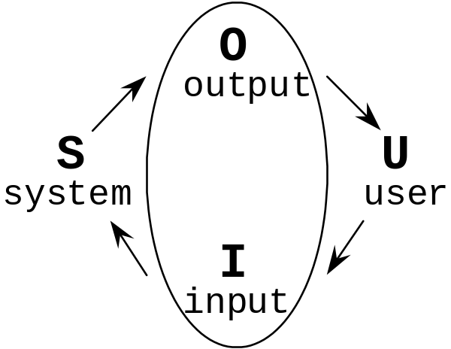
Interaction Frameworks - 4
extended by Abowd and Beale:
their interaction framework has 4 parts
• user
• input
• system
• output
each has its own unique language
interaction ⇒ translation between languages
problems in interaction = problems in translation

Slide 6
Interaction Frameworks - 5
user intentions translated into actions at the interface
→ translated into alterations of system state
→ reflected in the output display
→ interpreted by the user
general framework for understanding interaction
• not restricted to electronic computer systems
• identifies all major components involved in interaction
• allows comparative assessment of systems
• an abstraction

Slide 7
Ergonomics
Study of the physical characteristics of interaction
Also known as human factors.
Ergonomics good at defining standards and guidelines for constraining the way we design certain aspects of systems.

Slide 8
Ergonomics - examples
• arrangement of controls and displays
e.g. controls grouped according to function
or frequency of use, or sequentially
• surrounding environment
e.g. seating arrangements adaptable to cope with all sizes of user
• health issues
e.g. physical position ), lighting, noise,
environmental conditions (temperature, humidity
• use of colour
e.g. use of red for warning, green for okay,
awareness of colour-blindness etc.

Slide 9
Interaction styles
Interaction: dialogue between computer and user
Some applications have very distinct styles of interaction.
We can identify some common styles
• command line interface
• menus
• natural language
• question/answer and query dialogue
• form-fills and spreadsheets
• WIMP

Slide 10
Command line interface
Way of expressing instructions to the computer directly.
function keys, single characters,
short abbreviations, whole words, or a combination
• suitable for repetitive tasks
• better for expert users than novices
• offers direct access to system functionality
• command names/abbreviations should be meaningful
Typical example: the Unix system

Slide 11
Menus
Set of options displayed on the screen
Options visible
– less recall - easier to use
– rely on recognition so names should be meaningful
Selected by using mouse, numeric or alphabetic keys
Often options hierarchically grouped: sensible grouping is needed
Menu systems can be
• purely text based, with options presented as numbered choices
• graphical selected by arrow keys
• graphical selected by mouse
• combination (e.g. mouse plus accelerators)
Restricted form of full WIMP system

Slide 12
Natural language
Familiar to user
Use speech recognition or typed natural language
Problems
• vague
• ambiguous
• hard to do well!
Solutions
• try to understand a subset
• pick on key words

Slide 13
Query interfaces
Question/answer interfaces
• user led through interaction via series of questions
• suitable for novice users but restricted functionality
• often used in information systems
Query languages (e.g. SQL)
• used to retrieve information from database
• requires understanding of database structure and
language syntax, hence requires some expertise

Slide 14
Form-fills
Primarily for data entry or data retrieval
Screen like paper form.
Data put in relevant place.
Requires
• good design
• obvious correction facilities

Slide 15
Spreadsheets
first spreadsheet VISICALC first; followed by Lotus 1-2-3
MS Excel most common today
sophisticated variation of form-filling.
• grid of cells contain a value or a formula
• formula can involve values of other cells
e.g. sum of all cells in this column
• user can enter and alter data
• spreadsheet maintains consistency

Slide 16
WIMP Interface
• Windows
• Icons
• Menus
• Pointers
(or windows, icons, mice, and pull-down menus)
default style for majority of interactive computer systems, especially PCs and desktop machines

Slide 17
Windows
Areas of the screen that behave as if they were independent terminals
• can contain text or graphics
• can be moved or resized
• can overlap and obscure each other,
or can be laid out next to one another (tiled)
• scrollbars allow the user to move the contents
of the window up and down or from side to side
• title bars describe the name of the window

Slide 18
Icons
• small picture or image
• represents some object in the interface
often a window or action
• windows can be closed down (iconised)
small representation ⇒ many accessible windows
• icons can be many and various
highly stylized or realistic representations.

Slide 19
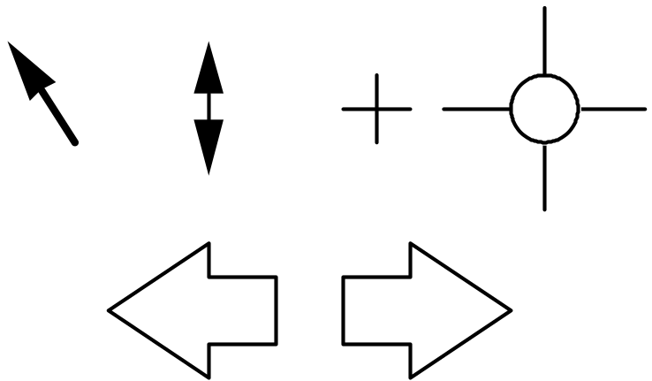
Pointers
• important component
WIMP style relies on pointing and selecting things
• usually achieved with mouse
• also joystick, trackball, cursor keys or keyboard shortcuts
• wide variety of graphical images

Slide 20
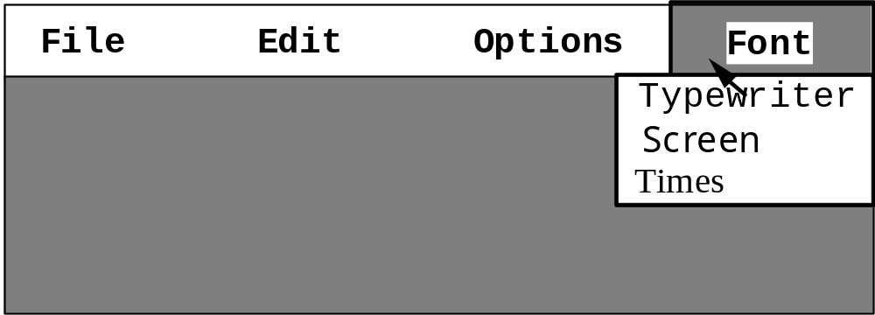
Menus
Choice of operations or services offered on the screen.
Required option selected with pointer
• problem - menus can take up a lot of screen space
• solution - menu appears when needed

Slide 21
Kinds of Menus
Menu Bar at top of screen (normally), menu drags down
• pull-down menu - mouse hold and drag down menu
• drop-down menu - mouse click reveals menu
• fall-down menus - mouse just moves over bar!
Contextual menu appears where you are
• pop-up menus - actions for selected object
• pie menus - arranged in a circle
- easier to select item (larger target area)
- quicker (same distance to any option)
… but not widely used!

Slide 22
Menus extras
Cascading menus
• hierarchical menu structure
• menu selection opens new menu
• and so in ad infinitum
Keyboard accelerators
• key combinations - same effect as menu item
• two kinds
- active when menu open - usually first letter
- active when menu closed - usually Ctrl + letter
- usually different !!!

Slide 23
Menus design issues
• which kind to use
• what to include in menus at all
• words to use (action or description)
• how to group items
• choice of keyboard accelerators

Slide 24
WIMP look and feel
Lots of things you can interact with:
• main WIMP components (windows,menus,icons)
• buttons
• dialogue boxes
• pallettes
Collectively known as widgets
appearance + behaviour = look and feel

Slide 25
Buttons
individual and isolated regions within a display
that can be selected to invoke an action.
Special kinds
• radio buttons - set of mutually exclusive choices
• check boxes - set of non-exclusive choices

Slide 26
dialogue boxes
information windows that pop up to inform of
an important event or request information.
E.g: when saving a file, a dialogue box is displayed to allow the user to specify the filename and location. Once the file is saved, the box disappears.

Slide 27
Pallettes and tear-off menus
Problem
• menu not there when you want it
Solution
• tear-off off and pin-up menus
stay around when
• pallettes little windows of actions
shown/hidden via menu option
e.g. available shapes in drawing package

Slide 28
Social and Organizational Context
Interaction affected by social and organizational context
• other people
- desire to impress, competition, fear of failure
• motivation
- fear, allegiance, ambition, self-satisfaction
• inadequate systems
→ cause frustration and lack of motivation

